Slide 1
30 - Day ICU Readmissions Predictive Modeling
Artificial Intelligence
Quinn Ramsay &
Crawford James
Fall 2025
Notes:
Crawford

Slide 2
Overview
ICU readmissions are linked to a six to seven fold increase in the odds of death, independent of other patient or hospital related factors.
Among Medicare beneficiaries, one in five patients is readmitted within 30 days, and 67% are readmitted within 90 days.
In 2004 alone, avoidable Medicare readmissions cost more than $17 billion.
Nationally, the annual cost of patient readmissions exceeds $52.4 billion, with an average cost of approximately $15,200 per readmission.
Notes:
Quinn

Slide 3
The Dataset
The MIMIC-IV dataset, version 3.1, available through PhysioNet, was selected for this project.
The Medical Information Mart for Intensive Care (MIMIC-IV) is a large, de-identified dataset containing information on patients admitted to the emergency department (ED) or an intensive care unit (ICU) at the Beth Israel Deaconess Medical Center in Boston, Massachusetts.
It includes hospital and critical care records for patients admitted between 2008 and 2022, encompassing more than 65,000 ICU admissions and over 200,000 ED visits.
MIMIC-IV is organized into two main components: ICU and HOSP
The HOSP module contains hospital-wide data extracted from electronic health records, including demographics, admissions, and laboratory results.
The ICU module provides detailed clinical information such as vital signs, medications, and fluid inputs.
Notes:
Quinn

Slide 4
Parameters
ICU Stay
length_of_stay, hospital_days, los_category
Demographics
age, gender
Severity & Risk
drg_severity, drg_mortality
Admission & Discharge
admission_type, admission_location, discharge_location
Medical History & Complexity
prior_icu_admits_last_year, days_since_last_icu, num_procedures, num_diagnoses
Comorbidities
chf, cad, diabetes, copd, ckd, afib, cancer
Labs, Procedures & Pharmacy
num_specimens, total_lab_events, num_icd_procedures, num_micro_tests, num_lab_items, max_diagnosis_seq, num_unique_icd_codes, num_unique_procedure_codes, num_unique_micro_tests, num_organisms_identified, num_pharmacy_items, total_med_administrations, has_infection
Notes:
Crawford

Slide 5
Methods
1
2
3
Logistic Regression
Random Forest
XGBoost
Notes:
Crawford

Slide 6
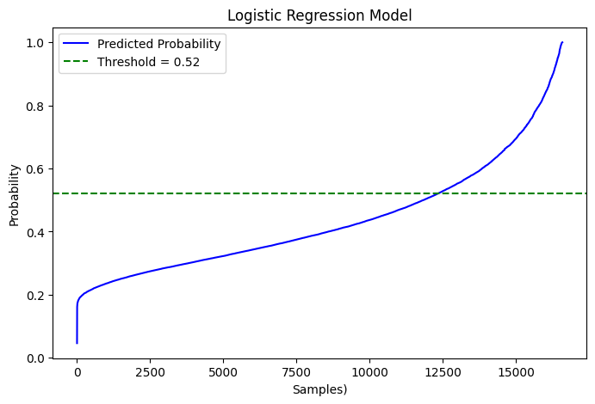
Logistic Regression
Logistic Regression predicts the probability of a binary outcome (e.g., yes/no, 1/0).
Uses the logistic function to model the relationship between features and the target.
Outputs a probability between 0 and 1.
A decision threshold is applied to classify outcomes; here, it was 0.52.
Produces a sigmoid-shaped curve representing the likelihood of an event, such as ICU readmission.
Notes:
Quinn

Slide 7
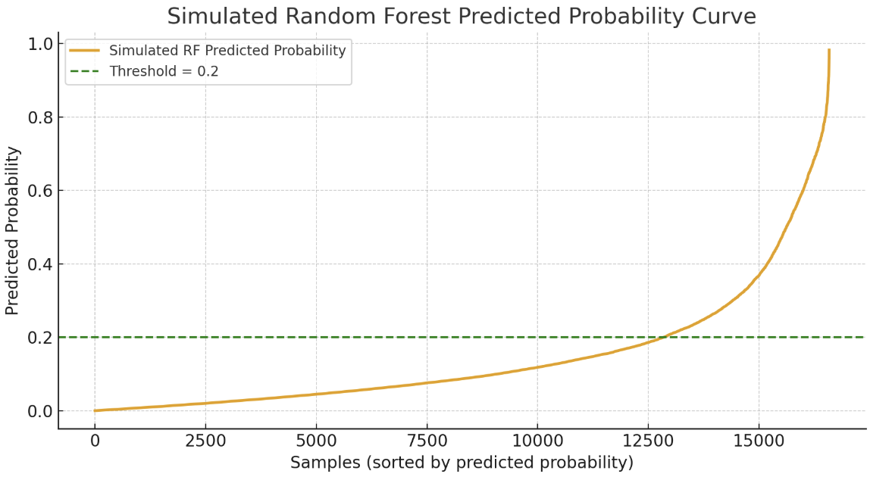
Random Forest
Random Forest is used for classification and regression.
Creates multiple decision trees while training occurs.
Each tree is trained on a random subset of the data.
FInal prediction is decided by a majority vote by all the trees.
The decision threshold for this model is 0.2.
Notes:
Crawford

Slide 8
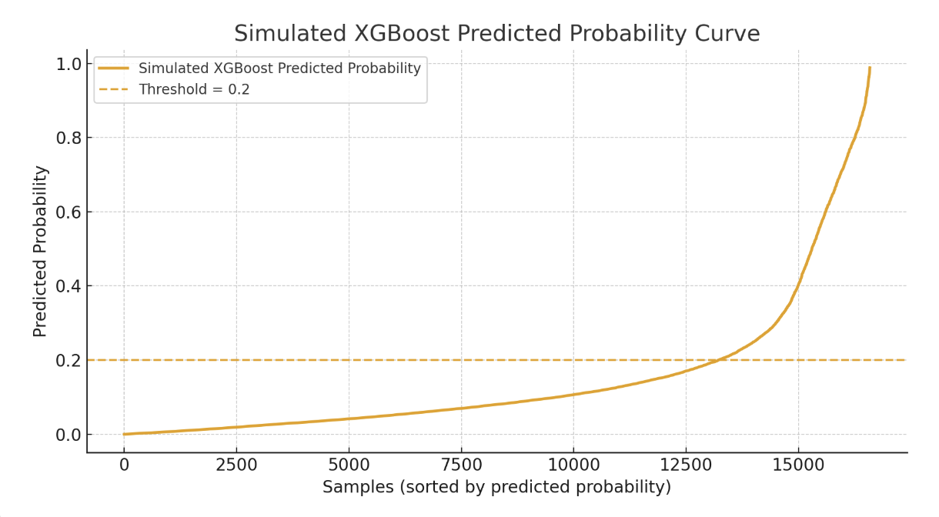
XGBoost
XGBoost creates different decision trees that. Each new decision tree is designed to fix the errors of the previous tree.
By using gradient descent and incorporating regularization techniques, it prevents overfitting.
The algorithm produces a probability score for each patient, showing the risk of readmission.
The score produced can be compared to a selected threshold to classify patient readmission.
Notes:
Crawford

Slide 9
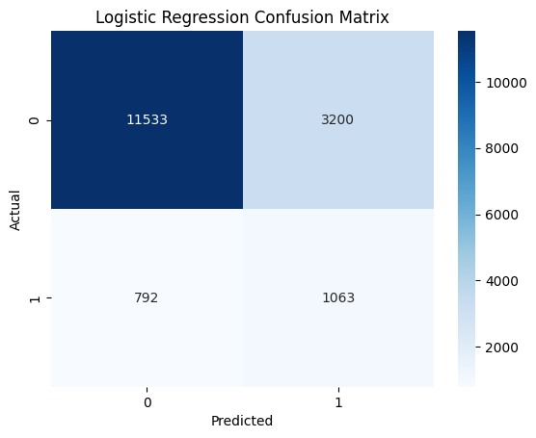
Results
In this project, model quality was assessed not only based on AUC-ROC, accuracy, and precision but also on the financial impact of the predictions. To calculate this we used a confusion matrix
the confusion matrix was used, detailing the model’s predictions as true positives, true negatives, false positives, and false negatives.
Financial data obtained from previous research and studies were applied to determine the costs associated with patients not readmitted, the costs of false readmissions, and the savings achieved by preventing unnecessary readmissions.
Notes:
Quinn

Slide 10
Results pt. 2
Model | AUC-ROC | Accuracy | Precision | Recall | Original Cost | Savings
Logistic Regression | 0.74 | 76% | 59.5% | 57% | $28,196,000 | $16,315,200
Random Forest | 0.744 | 76% | 59% | 56% | $28,196,000 | $16,162,200
XGBoost | 0.758 | 83% | 62.5% | 45% | $28,196,000 | $16,811,000
Notes:
Quinn

Slide 11
Conclusion
ICU readmissions are expensive and very common and by making a model that can create an early prediction is very beneficial.
The MIMIC-IV dataset was helpful with providing real world information to create our model.
Out of the three models we created, XGBOOST produced the best performance. It achieved an accuracy of 83%.
All the models showed a large amount of cost savings. XGBOOST had the best savings out of all models.
Machine learning shows a strong potential for improving early detection of ICU readmissions.
Notes:
Crawford

Slide 12
Thank you
Notes:
//

Slide 13
References
Beauvais, B., Whitaker, Z., Kim, F., & Anderson, B. (2022). Is the hospital value-based purchasing program associated with reduced hospital readmissions? Journal of Multidisciplinary Healthcare, 15, 1089–1099. https://doi.org/10.2147/JMDH.S358733
Blinder, Y. (n.d.). all_data.sql [SQL script]. GitHub. https://github.com/YaronBlinder/MIMIC-III_readmission/blob/master/all_data.sql
Deo, R. C. (2015). Machine learning in medicine. Circulation, 132(20), 1920–1930. https://doi.org/10.1161/CIRCULATIONAHA.115.001593
Golas, S. B., Shibahara, T., Agboola, S., Otaki, H., Sato, J., Nakae, T., Hisamitsu, T., Kojima, G., Felsted, J., Kakarmath, S., Kvedar, J., & Jethwani, K. (2018). A machine learning model to predict the risk of 30-day readmissions in patients with heart failure: A retrospective analysis of electronic medical records data. BMC Medical Informatics and Decision Making, 18(1), 44. https://doi.org/10.1186/s12911-018-0620-z
Inan, O. T., Tenaerts, P., Prindiville, S. A., Reynolds, H. R., Dizon, D. S., Cooper-Arnold, K., Turakhia, M. P., Pletcher, M. J., Preston, K. L., Krumholz, H. M., Marlin, B. M., Mandl, K. D., & Califf, R. M. (2020). Digitizing clinical trials. Journal of Personalized Medicine, 10(2), 21. https://doi.org/10.3390/jpm10020021
McNeill, H., & Khairat, S. (2020). Impact of intensive care unit readmissions on patient outcomes and the evaluation of the national early warning score to prevent readmissions: Literature review. JMIR Perioperative Medicine, 3(1), e13782. https://doi.org/10.2196/13782
Moerschbacher, A., & He, Z. (2023). Building prediction models for 30-day readmissions among ICU patients using both structured and unstructured data in electronic health records. In Proceedings of the IEEE International Conference on Bioinformatics and Biomedicine (pp. 4368–4373). https://doi.org/10.1109/bibm58861.2023.10385612
Toma, M., & Wei, O. C. (2023). Predictive modeling in medicine. Encyclopedia, 3(2), 590–601. https://doi.org/10.3390/encyclopedia3020042
Notes:
//

